Slide 1
JAVA 9 Lambda, Performance, Debugging Tools
【NCOS Internal Use Only】
Global Delivery Center Philippines
NEC Telecom Software Philippines, Inc.
December 7, 2017

Slide 2
Notes:
＃本スライドの活用について
NECグループのブランドステートメント「Orchestrating a brighter world」は、ステークホルダーへの約束として、NECグループの企業姿勢、実現したい世界観と、それに対する自らの「行動・能力」を表現したものです。
社外向け発信活動においては、必ず表紙の次ページに本スライドを挿入し、ブランドステートメントとともにどんなストーリーを展開するかを説明するように心掛けてください。
＜セリフ例＞-----
私たちNECグループは、お客さまや社会と共創して、社会価値を創造していきます。
人が生きる、豊かに生きる、そして明るい未来につなげていくために。
これをブランドステートメント「Orchestrating a brighter world」としました。
NECグループが目指しているこの方向性の中で、本日は、○○○を実現する具体的な取り組み（ソリューション、サービス、技術）についてご説明します。
-----------------
※そのほか、言葉に込めた意味、マークデザインに込めた意味については、「NEC Brand Principles」で確認してください。

Slide 3
Java 9 Lambda, Performance, Debugging Tools
１. Lambda Expressions Updates
2. Performance Comparison
3. Debugging Tools

Slide 4
１. Lambda Expressions Updates

Slide 5
１. Lambda Expressions Updates
The Java 9 release notes does not include any language updates for the Lambda Expressions.
Repository of the lambda prototype
http://hg.openjdk.java.net/lambda
Java 9 Language updates documentation
https://docs.oracle.com/javase/9/language/toc.htm
OpenJDK Project for Lambda
http://openjdk.java.net/projects/lambda/
No difference in Java language and VM specifications in Java SE
Java 8: https://docs.oracle.com/javase/specs/jls/se8/html/jls-15.html#jls-15.27
Java 9: https://docs.oracle.com/javase/specs/jls/se9/html/jls-15.html#jls-15.27

Slide 6
2. Performance Comparison

Slide 7
2. Performance Comparison
 | Details | Results
HTTP 2.0 Speed performance | HTTP 2.0 vs HTTP 1.1 | HTTP 2.0 provides greater speed ranging from 11.81% to 47.7%
Compact Strings | Surface level test: Difference between enabling and disabling Java 9 compact strings Create 10 million string and appending | Enabled: 10M strings generated in 854 ms. string of length 488895 created in 5130 ms. Disabled: 10M strings generated in 936 ms. string of length 488895 created in 9727 ms. There is a 47.26% improvement when compact string is enabled.
Contended monitor performance | One method call for a contended monitor at different threads | JDK 8: needs 2580ns for 16 threads JDK 9: needs 1655ns for 16 threads – improved by more than 60%

Slide 8
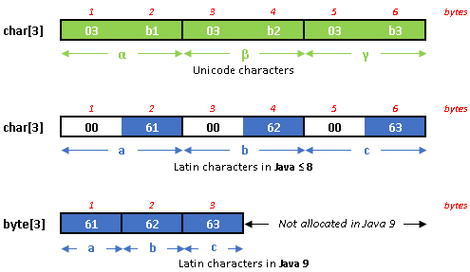
2. Performance Comparison
Compact Strings
In Java 8 and other previous versions, String is represented as char[] array, wherein each char takes up 2 bytes of memory.
However in Java 9, String is now stored in byte[] instead of char[]. Strings are stored depending on the type of characters:
Strings containing Unicode characters:
2 bytes are allocated for each character, same as in Java 8 and previous versions.
Strings containing only Latin characters:
1 byte is allocated for each character, thus saving memory.
*For Unicode characters “α”, “β”, and “γ”, both bytes are allocated for each character. This is true to both Java 9 and other versions.
*In Java 8 and previous versions, Latin characters “a”, “b”, and “c” are handled so that the first bytes allocated for each characters are filled with zeros, making it effective unused.
*In Java 9, Latin characters “a”, “b”, and “c” are each allocated in a single byte. This reduces memory footprint and improves allocation rate.
Characters and values used as examples:
α = \u03b1 a = \u0061
β = \u03b2 b = \u0062
γ = \u03b2 c = \u0063

Slide 9
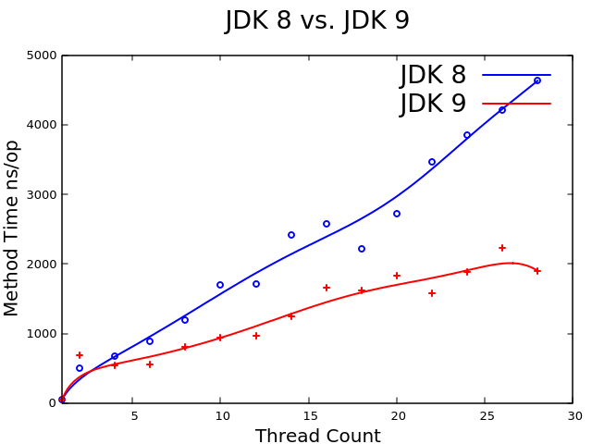
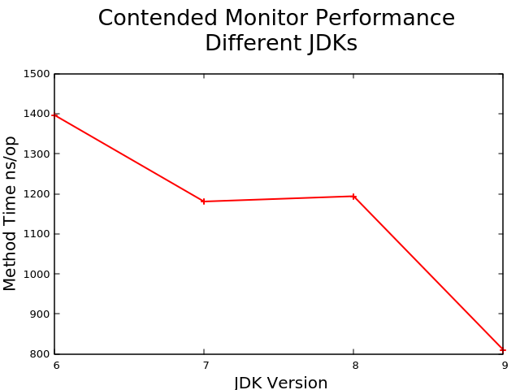
2. Performance Comparison
Contended monitor performance:
The figures below, shows the performance of JDK versions for threads accessing the same monitor. The lower the time for one method call means better performance.
*All graph details are results from the same environment.
As the number of thread count increases, the time needed for one method call in JDK 8 is greater than the time needed for one method call in JDK 9.
For 8 threads accessing the same monitor, JDK 9 has the lowest time needed for one method call, while a much higher time is needed for the previous JDK versions.

Slide 10
2. Performance Comparison
References:
http://blog.takipi.com/5-features-in-java-9-that-will-change-how-you-develop-software-and-2-that-wont/
http://www.baeldung.com/java-9-compact-string
https://www.linkedin.com/pulse/your-applications-run-faster-java-9-eur-ing-ioannis-kolaxis-msc
http://vmlens.com/articles/performance-improvements-of-java-monitor/

Slide 11
3. Debugging Tools

Slide 12
3. Debugging Tools
Comparison of tool features:
 | Eclipse MAT | VisualVM | JDK tools | Eclipse IDE Debugger | NetBeans IDE | IntelliJ IDEA
Check memory leak | ○ | ○ | × | × | ○ | ×
Thread count | × | × | × | × | × | ×
Check deadlock | × | ○ | ○ | × | ○ | ○
Heap dump | ○ | ○ | ○ | × | ○ | ×
Thread dump | × | ○ | ○ | × | × | ○
Analyze Threads | ○ | × | × | ○ | × | ○
Remote debugging | × | ○ | ○ | ○ | × | ○

Slide 13
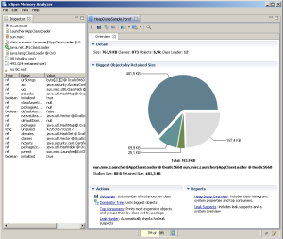
3. Debugging Tools
Eclipse MAT or Memory Analyzer:
MAT is an Eclipse project designed to analyze Java heap dumps. It can be used as stand-alone or plug-in in Eclipse IDE. It is a fast and feature-rich Java heap analyzer that helps find memory leaks and reduce memory consumption.
As a stand-alone, Memory Analyzer is based on Eclipse 4.5 (Mars). The Eclipse IDE which supports Java 9 is the current version 4.7 (Oxygen).
MAT is available for download as stand-alone at: https://www.eclipse.org/mat/downloads.php
As a plug-in in Eclipse IDE, it can be searched in the Eclipse Marketplace under Help.
Memory leak: Can inspect heap dump for leak suspects. Example: objects, sets of objects that are suspiciously big
Heap Dump: Acquire and open heap dump. Such heap contains information about all the Java objects alive at a given point in time.
Analyze Threads: Provides several queries to inspect the threads at the moment the snapshot was taken.

Slide 14
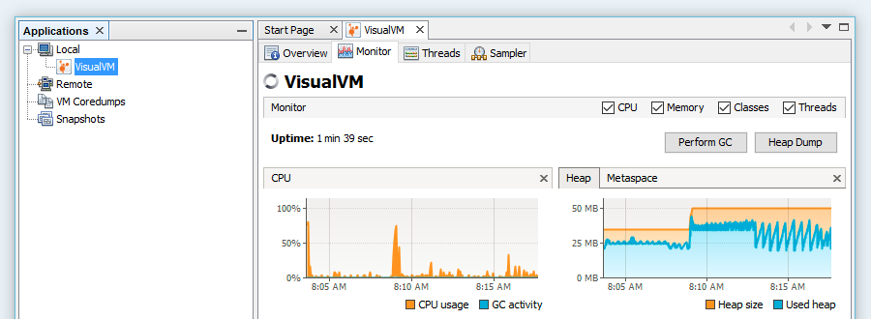
3. Debugging Tools
VisualVM:
A visual tool integrating command line JDK tools and lightweight profiling capabilities. Designed for both development and production time use.
Latest release of VisualVM, version 1.3.9, includes an experimental support for running on JDK 9, and monitoring/profiling Java 9 processes.
VisualVM can be downloaded at: http://visualvm.github.io/
Memory leak: Memory snapshots created on demand or on OutOfMemoryError help with debugging memory leaks.
Deadlock: Discover distributed deadlocks through simultaneous thread dumps of multiple processes.
Heap dump: can be used to browse the contents of a heap dump and take a heap dump of a local running application.
Thread dump: Create and display thread dumps for an immediate insight of what is going on in the target process.
Remote debugging: Can view and monitor application and threads.

Slide 15
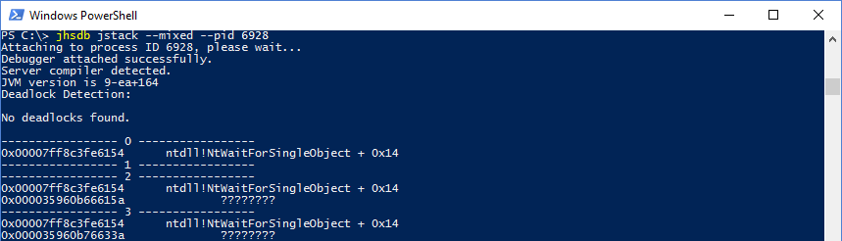
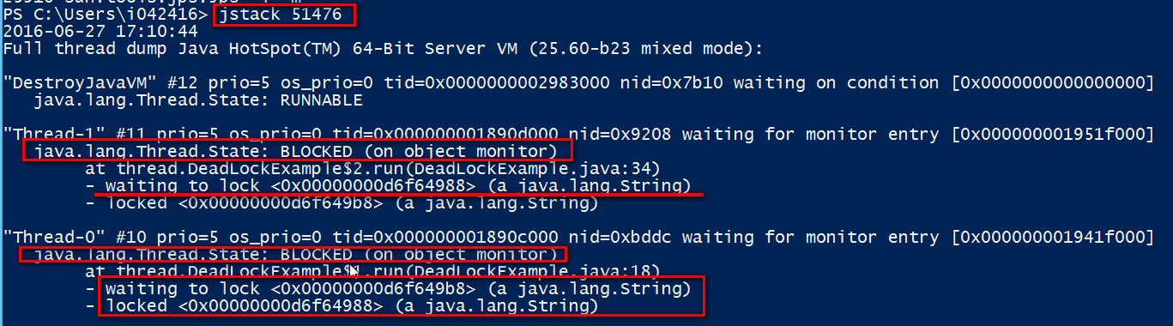
3. Debugging Tools
JDK tools:
The following tools are available in the JDK 9 release. These tools are bundled together with the JDK 9 and can be used immediately in the command line interface after JDK installation. Some of these tool identified as experimental are unsupported and may not be available in future JDK versions.
Deadlock: The jhsdb tool in jstack mode provides deadlock detection details and information on thread locks. Separate tool jstack of the same name is also capable of such function, this tool is experimental in JDK 9.

Slide 16
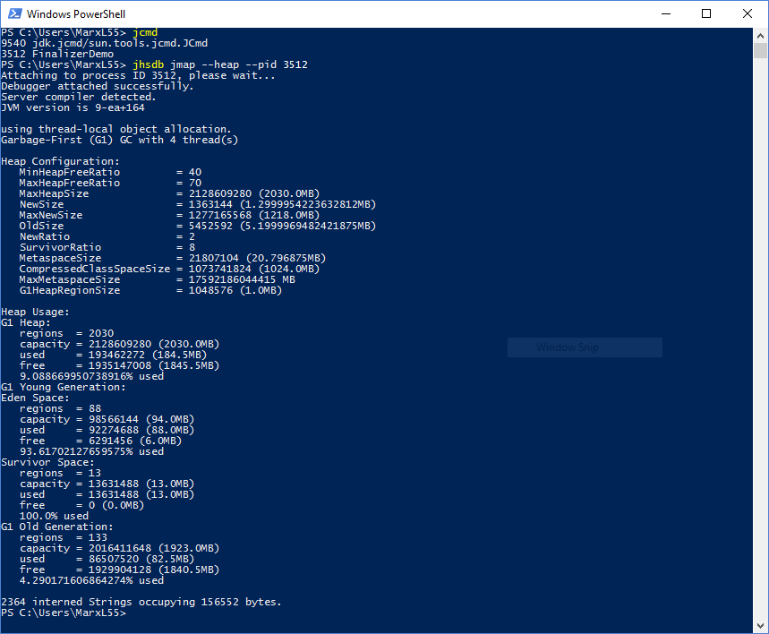
3. Debugging Tools
Heap dump: The jhsdb tool in jmap mode provides functions similar to that of the separate tool with the same name jmap. These functions include heap dump and class histogram. The separate tool jmap is experimental in JDK 9. Another tool jcmd, can also be used to do heap dumps.

Slide 17
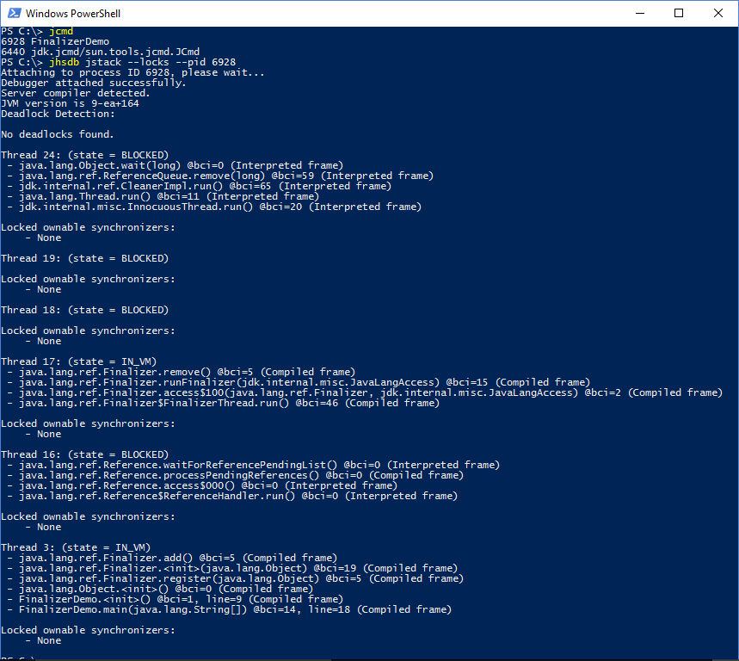
3. Debugging Tools
Thread dump: The same tool jhsdb in jstack mode can be used to take thread dumps. Similarly the separate tool jstack and jcmd have the same functionality.

Slide 18
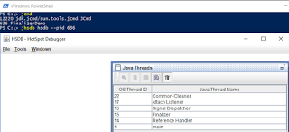
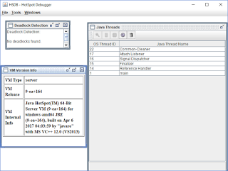
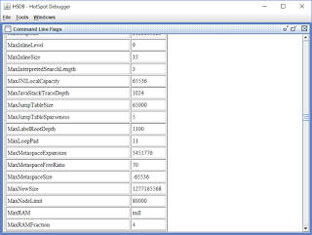
3. Debugging Tools
Remote debug: The jhsdb hsdb and clhsdb can be attached to debugd mode. The debugd mode is used for remote server debug.

Slide 19
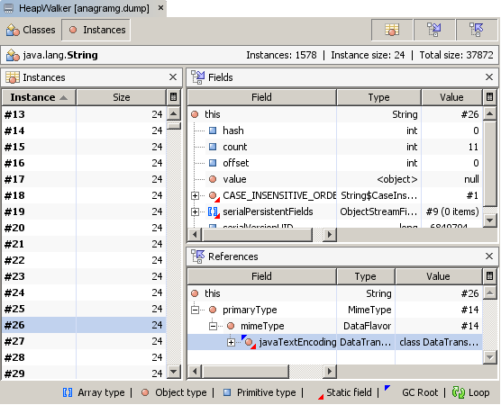
3. Debugging Tools
NetBeans IDE:
A NetBeans Debugger and Profiler tools useful for evaluating Java heap contents, searching for memory leaks, and detect deadlocks.
NetBeans 8.2, current version, does not support JDK 9. However, the upcoming NetBeans 9, no release date yet, will have Java 9 support. This includes the profiler to work with JDK 9 apps.
Netbeans IDE can be downloaded at:
https://netbeans.org/downloads/
Deadlock: Identify potential deadlock situations by automatically searching for deadlock among all suspended threads. Displays notifications in debugging window and identifies involved threads when a deadlock is detected.
Memory leak: The profiler’s HeapWalker allows browsing instances or classes holding reference to a particular instance to discover memory leaks.
Heap dump: Can create, open, and browse heap dump using the profiler.

Slide 20
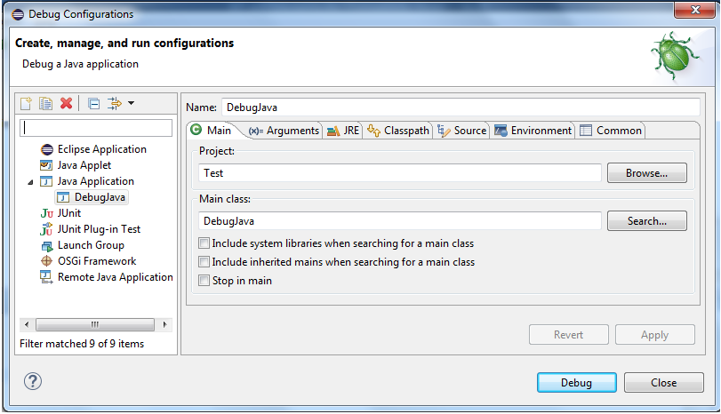
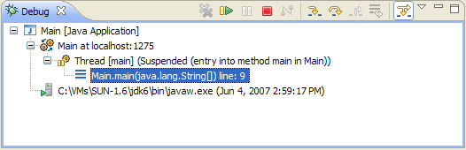
3. Debugging Tools
Eclipse IDE debugger:
The Eclipse IDE provides many debugging tools and view in the Debug Perspective to help developers debug effectively and efficiently.
The latest Eclipse version 4.7 (Oxygen) currently supports Java 9.
The latest version is available at: https://www.eclipse.org/downloads/
Analyze threads: Use breakpoints to suspend the execution of the thread at the location where breakpoint is set. Can be done in multiple threads.
Remote debugging: The source code of the application should be available in the IDE for remote debugging

Slide 21
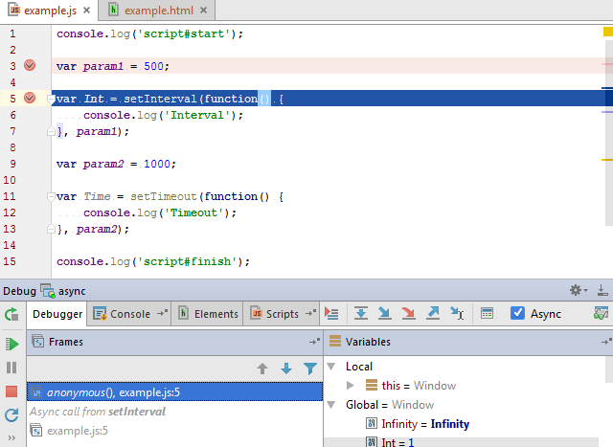
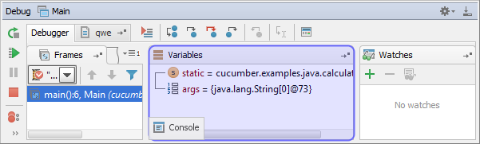
3. Debugging Tools
IntelliJ IDEA:
The IntelliJ IDEA Debug tool window becomes available when you start debugging. Output from debugging sessions for application are displayed.
Java 9 is supported in the latest release of the IntelliJ IDEA, version 2017.2.
The community edition can be downloaded at:
https://www.jetbrains.com/idea/download/previous.html
Deadlock: In the dump tab of the window, deadlocks are displayed and highlighted in red.
Thread dump: threads are listed and sorted starting from the most meaningful and useful thread on the top of the list, threads are displayed in gray text.
Analyze threads: The Thread pane shows all threads of a process as a tree view, and allows exploring them, customizing thread view, and exporting to a file.
Remote debug: To perform remote debugging, the corresponding server must be already running, the remote configuration don’t start a server.

Slide 22
3. Debugging Tools
References
https://www.eclipse.org/mat/
http://help.eclipse.org/oxygen/index.jsp?topic=%2Forg.eclipse.mat.ui.help%2Fwelcome.html
http://visualvm.github.io/features.html
http://visualvm.github.io/relnotes.html
http://marxsoftware.blogspot.jp/2017/06/jhsdb-jdk9.html
https://docs.oracle.com/javase/9/tools/tools-and-command-reference.htm#JSWOR596
https://netbeans.org/features/java/debugger.html
https://www.eclipse.org/community/eclipse_newsletter/2017/june/article1.php
https://www.jetbrains.com/help/idea/debug-tool-window.html
https://www.jetbrains.com/help/idea/working-with-server-run-debug-configurations.html

Slide 23
Glossary
Term
Monitor | Mechanism that ensures only one thread can execute a given section(s) of code at any given time.
Contended Monitor | it is when the synchronized block is called by many threads

Slide 24
Revision History
Version Number | Date | Author | Reviewer | Description
00.01 | 2017/11/22 | NSP-arriesgado.ap |  | Initial Creation
00.02 | 2017/12/01 | NSP-arriesgado.ap |  | Review comment updates
00.03 | 2017/12/07 | NSP-arriesgado.ap |  | Additional: -Section 2 example details -Section 3 download links

